Slide 1
MS2 +PK/Saliva
9 Samples

Slide 2
Reaction setup
1e3 pfu/rxn MS2 template
0.90 uM primer
0.125 uM probe
3.2 U/uL RT
1x Promega Buffer
60% saliva
1/100 dilution Protease K (0.20 ug/uL)
Heat template
95°C for 5 min
Combine primer, probe, template, RT
Treat saliva with PK
65°C for 5 min
95°C for 5 min
Add saliva to MM

Slide 3
PCR Protocol
45°C for 1 min
95°C for 1 min
50 cycles
95°C for 1 sec
60°C for 1 sec

Slide 4
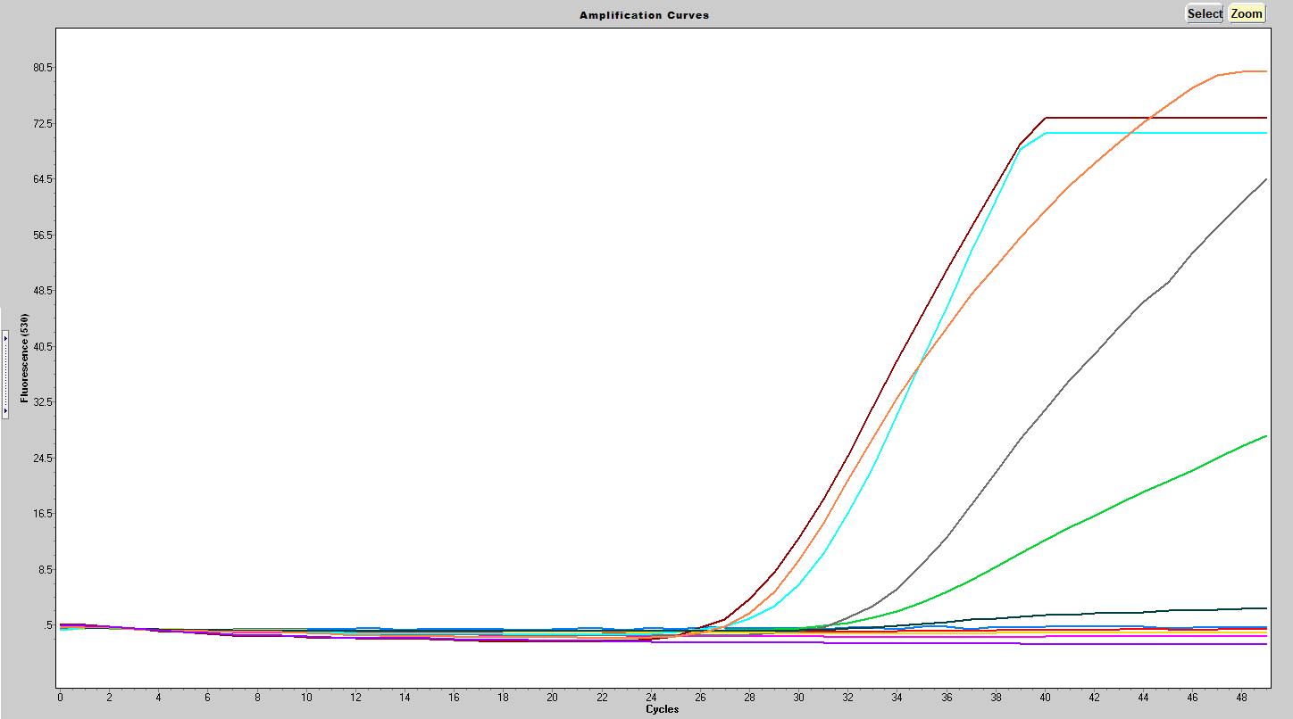
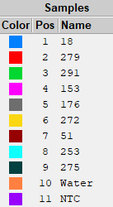
Results
Sample | Cp | Fmax
18 | NA
279 | NA
291 | 33.58 | 27.9
153 | NA
176 | 33.30 | 65.0
272 | NA
51 | 28.20 | 73.8
253 | 30.30 | 71.7
275 | 31.77 | 3.0
Water | 28.31 | 80.5
NTC | NA

Slide 5
Next Steps
Swish & Spit
PK inhibitor
Treat saliva @ 62

